Slide 1
ATM TRANSACTION QUEUE SYSTEM
ATM OPERATIONS

Slide 2
1.INTRODUCTION:
The project simulates an ATM Transaction Queue System.
It focuses on :
How customers are added to queue.
How their With drawl transactions are processed.
How they are removed from the queue after a successful transaction.
It uses a QUEUE DATA STRUCTURE , implemented via a linked list in C , to manage the flow of customers in a First-In-First-Out(FIFO) order.
It shows the real time operations of an ATM.

Slide 3
22.Objective
To model a simple ATM queue system using core programming and data structure concepts.
To implement queue operations such as enqueue(add customer) ,
dequeue(process and remove customer).
To reinforce understanding of dynamic memory management and linked lists in c .
To simulate real-world scenarios using programming logic for educational and practical learning.

Slide 4
3.Why C and DSA ?
C programming Language :
Offers low–level memory manipulation , making it efficient for system-level applications.
Provides fast execution , ideal for real-time simulations like ATM systems.
Encourages learning foundational programming concepts.
Data structures & Algorithms (DSA):
Queue(FIFO) is best for managing services lines like ATM queues , call centers , ticket counters , etc.
Enhances logical thinking , and problem solving ability , and builds efficient software solutions.
Implementing with Linked Lists allows dynamic memory allocation , which avoids overflow unless system memory is full.

Slide 5
4.Algoritm
Step 1 : Initialize an empty queue.
Step 2 : Display menu :
Add customer
Process Transaction
Display Queue
Exit
Step 3 : Based on the option :
Add customer :
Input : ID , Name , with drawl Amount.
Create a node and add it to the rear of the queue.

Slide 6
Process transaction :
If queue is not empty :
Retrieve customer at front.
Simulate with drawl with output message.
Remove customer from queue.
Else : Show empty queue message.
Display Queue :
Traverse from front to rear and display all customers .
Step 4 : Repeat until the user exits.

Slide 7
5.Take Away
Gained practical knowledge and experience with implementing dynamic data structures in c .
Understood how queue operations can be applied to real-world systems like ATMs.
Improved logic-building and code structing skills .
Learned to handle user input , memory allocation , and deallocation efficiently .
Experienced simulating real-life service systems using simple console-based programming.

Slide 8
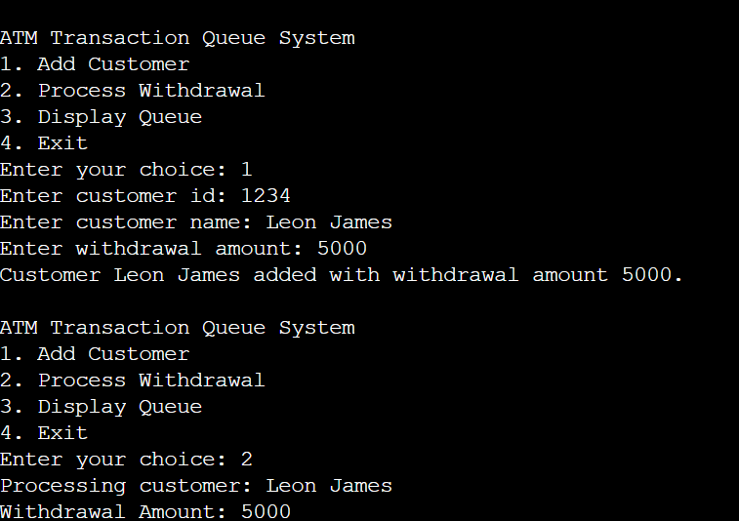
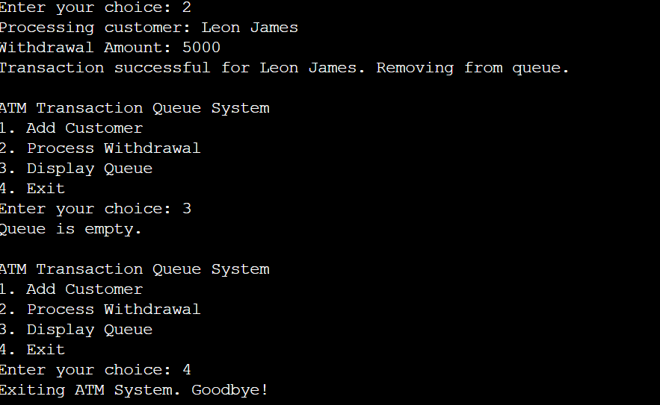
Output images

Slide 9
Sample output
ATM Transaction Queue System
1. Add Customer
r2. Process Withdrawal
3. Display Queue
4. Exit
Enter your choice: 1
Enter customer id: 7777
Enter customer name: Rolex
Enter withdrawal amount: 2000
Customer Rolex added with withdrawal amount 2000.
ATM Transaction Queue System
1. Add Customer
2. Process Withdrawal
3. Display Queue
4. Exit
Enter your choice: 4
Exiting ATM System. Goodbye!

Slide 10
Thanking You All !
Team members:
M . Mokshitha(24KB1A05AC)
P . Sri Lakshmi(24KB1A05CP)
P . Poojitha(24KB1A05CV)
M . Hasini(24KB1A05Z8)

